Slide 1
POD TALK/SHARE Chapter 1-4
1. Share the information you have gathered for all of the following for Chapters 1-4:
Character Attribute Web
Story Maps
Study Guide Questions
2. Share your predictions questions and reasoning with each other
3. Compose a list of at least three qualities of each of the following characters:
Ender
Peter
Valentine
Graff

Slide 2
Writing Prompt 1 – W.7.4
Pretend that you are Peter or Valentine and write a letter to Ender on the day that he is taken to Battle School.
In your pods, compare and contrast your members’ letters from Valentine versus the one’s from Peter.
How were each letter similar and different based on whose perspective your pod members chose to write from.
Valentine: Differences
Valentine/Peter: Similarities
Peter: Differences

Slide 3
POD TALK/SHARE Chapter 1-4
What are some possible themes of Ender’s Game we have already encountered?

Slide 4
POD TALK/SHARE Chapter 1-4
What are some possible themes of Ender’s Game we have already encountered?
Major Themes:
Good vs. Evil
Children vs. Adults
Minor Themes:
Don’t judge a book by its cover.

Slide 5


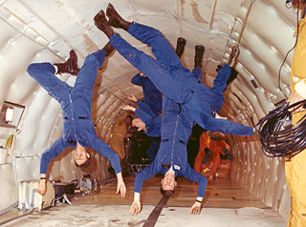


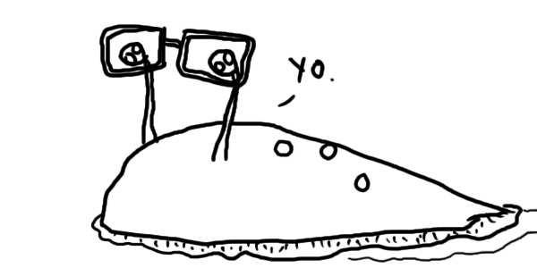
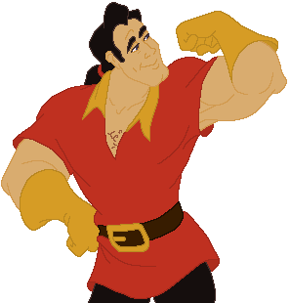


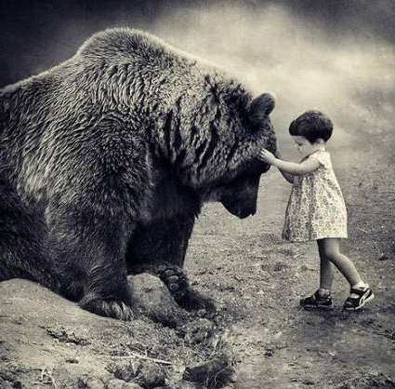
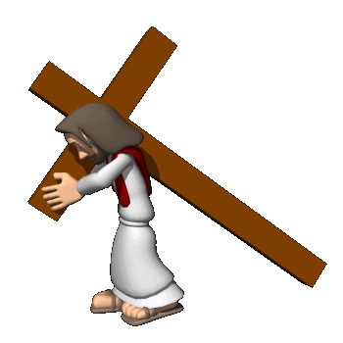


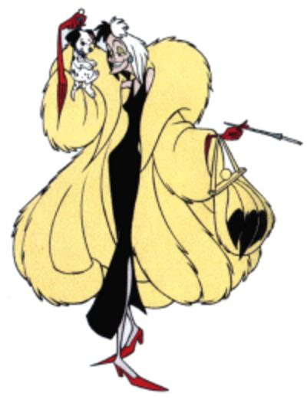
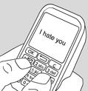
Ender’s Game Vocabulary: Chapters 5 and 6
ambitious: eager to obtain success
amplifying: to make larger, greater, or stronger
arrogant: claiming to be more important
compassion: a deep sympathy with a desire to help
contempt: to consider a person or thing worthless and deserving of disrespect
excel: to be exceptionally good in something
holographic: an image displayed in three-dimensions
inadequate: lacking in quality or quantity
martyr: a person killed because of religious beliefs
mercilessly: in a way without forgiveness; cruel
orientation: physical position and direction
sluggishness: slow-moving
sullen: in a bad mood and not wanting to talk
tactical: actions carefully planned toward a goal
tormented: to cause mental or physical suffering

Slide 6
Chapter 5-6 Book Summary
Ender takes the bottom bunk near the door and learns how to work his locker via the scanner. He likes the game rooms, but prefers the holographic games played by the older boys. He challenges one boy to two out of three games, and he wins the last two by inventing new moves. He soon makes an enemy out of a boy named Bernard. In the battleroom, Ender learns how to control null gravity. He bonds with Alai, one of Bernard’s friends, and Alai becomes the bridge that brings the class together. During study time, Ender participates in Free Play.

Slide 7
Chapter 5-6 Study Guide Questions
What bunk does Ender get? The lower bunk by the door
What is in the compartment with the space suit? A pistol
What is the boys’ color code? Red, yellow, yellow
What does it mean to “ice out”? To be sent back to Earth
Which games does Ender study in the older boys’ area? The holographic ones with hovering objects
What is the first message Ender sends on the desk? “Cover your butt. Bernard is watching.”
Who is the first of the Launchies to befriend Ender? Shen
Who does Ender approach in the battleroom? Alai
What happens when Ender is shot in the foot? The leg of his suit is frozen
Who are the four boys who take on the rest of the class? Ender, Alai, Shen, and Bernard
Who is chosen as launch leader? Alai
How does Ender win against the Giant? He kicks over the death drinks and attacks the Giant’s eye, killing him.

Slide 8
Prediction Question 3 (Chpt 5-6):
Fill in all characters we have encountered in your prediction chart and then respond to the prompt: Alai is Ender’s bunk mate when Graff tells the Launchies the soldier to their left and right are not their friends but their competition.
Will Alai become one of Ender’s allies (friends)?

Slide 9
Prediction Question Chapter 5-6
3. 5-6: Will Alai become one of Ender’s allies?
Chapter/Pages | CHARACTERS | CONFLICT | PREDICTION | WHY? | CORRECT?
Chpt 5-6 | Anderson Dap Alai Bean Bernard | Ender v Launch Group/Older Boys in gameroom (CvS) Ender v Bernard (CvC) | Alai will/will not become one of Ender’s allies. | I predict this because…

Slide 10
Chapter 5-6 Media Compare and Contrast
The Game Room: 01:09:30 – 1:14:06 (Book, pg. 77-81)
How did going back to read about the game room help you better understand who Ender is as a tactician (soldier/leader)?
Categorize and record information discussed in your pod and in class in your character attribute web.
Identify at least two adjectives that describe Ender to add to your Sociogram activity sheet.
1st: (T) Plans ahead using what he has observed and learned from the situation (GR while watching other boys “I could beat them this way. I could beat them that way.” (pg 79) Sociogram Adjectives (ENDER): Observant, smart, inventive, tactical, not gullible
2nd: (D) Caught on quickly by watching older boys. Learned controls and maneuvers by their hand movements. (T) The book offers internal dialog to Ender’s thought patterns as he was observing in the game room.
5th: (*Shared similar to 1st/2nd) Sociogram Adjectives (ENDER): Tough, brave, smart, agile, trustworthy, tactical, skillful, inventive
7th: (D) He studied the game and came up with a strategy before challenging one of the older boys. (S) Goaded the older boys by saying “If you can’t do it twice, you can’t do it at all.” (pg 80) (T) He thinks he is skilled enough to learn the game quickly and defeat the older boys. Sociogram Adjectives (ENDER): cunning, smart, witty, strategic, independent, strong, tactical, inventive

Slide 11
Character Attribute Web: Chapters 5-6
f
What Ender thinks:
What Ender says:
What Ender does:
The book offers internal dialog to Ender’s thought patterns as he was observing in the game room.
He thinks he is skilled enough to learn the holographic games quickly and defeat the older boys.
“I’m a murderer, even when I play. Peter would be so proud of me.” (pg 98)
Plans ahead using what he has observed and learned from the situation (GR while watching other boys “I could beat them this way. I could beat them that way.” (pg 79)
Goaded the older boys by saying “If you can’t do it twice, you can’t do it at all.” (pg 80)
Caught on quickly by watching older boys. Learned controls and maneuvers by their hand movements.
He studied the game and came up with a strategy before challenging one of the older boys.
Rather than “following the rules” and continuing to die, Ender killed the Giant (viciously).
Environment (School/Home/Battle School):
What others do to Ender:
Ender is still an outcast, but he is strategically building relationships with the other soldiers.
Bernard began creating conflict between Ender and the other launchies.
Lt. Anderson gives Ender access to the mind game so she can analyze his mental/emotional state.
Andrew Wiggin
“Ender”
.
Authority interaction or inaction and how it affects Ender’s decisions:
Other conflicts that affect Ender:
.
.
.
.
.

Slide 12
Chapter 5-6 Media Compare and Contrast
The Battleroom: 01:21:16 – 01:34:38 (Book, pg. 88-95)
Compare how the book explains the relationships between Ender and the other soldiers versus the movie. Use a Vinn Diagram to organize your data. What relationships are introduced in the book/movie? How did the book/movie make the reader/viewer understand the importance of these relationships? Consider Ender’s relationships with Alai and Bernard as well as his launch group in general.
Book: Differences
Book/Movie: Similarities
Movie: Differences
1st: Ender broke Bernard's arm on launch ship, causing conflict between the characters as well as Ender and the launch group. Ender is bullied by several of the launch group and Bernard. In the BR, Ender interacts with and builds a relationship with Alai to create a bridge between Ender and the other soldiers.
1st: Both introduces reader/viewer to the BR.
1st: Bean is the soldier in the BR rather than Alai. There is no conflict or conflict resolution shown between Ender and the other soldiers in the BR.

Slide 13
Chapter 5-6 Media Compare and Contrast
The Battleroom: 01:21:16 – 01:34:38 (Book, pg. 88-95)
Compare how the book explains the relationships between Ender and the other soldiers versus the movie. Use a Vinn Diagram to organize your data. What relationships are introduced in the book/movie? How did the book/movie make the reader/viewer understand the importance of these relationships? Consider Ender’s relationships with Alai and Bernard as well as his launch group in general.
Book: Differences
Book/Movie: Similarities
Movie: Differences
2nd: Bernard was the boy whose arm Ender broke on launch and becomes a source of conflict – bullying in the bunks. Alai and Ender interacted in the BR examining equipment and null gravity. Ender uses this new friendship to mend conflict with Bernard and other soldiers. Alai and Ender teamed up with Bernard and Shen to take on the rest of the launch group.
2nd: Both show some conflicts among the lauchies, but not in the BR. Both book and movie contain scenes from the BR.
2nd: Shows Bean and Ender interacting in the BR examining equipment and null gravity rather than Alai. Does not show the mock battle between Ender and the other boys against the rest of the soldiers in the BR.

Slide 14
Chapter 5-6 Media Compare and Contrast
The Battleroom: 01:21:16 – 01:34:38 (Book, pg. 88-95)
Compare how the book explains the relationships between Ender and the other soldiers versus the movie. Use a Vinn Diagram to organize your data. What relationships are introduced in the book/movie? How did the book/movie make the reader/viewer understand the importance of these relationships? Consider Ender’s relationships with Alai and Bernard as well as his launch group in general.
Book: Differences
Book/Movie: Similarities
Movie: Differences
7th: Ender interacts with Alai in the BR, learning equipment and maneuvers. The conflict with Bernard and the other launchies is explained (Ender broke his arm on the launch ship). Ender and Alai team up with Bernard and Shen and take on the rest of their launch group who is still flailing around uncontrollably.
7th: Ender learned how to maneuver and fire the laser pistol in null gravity (BR scene was in both). The pistol freezes the suits where they hit. The soldiers at the Battle School have to examine the last battles videos to better understand their enemy (the buggers).
7th: Ender does not do as much to gain respect of the soldiers, it does not fully explain the conflict with Bernard and other launchies. Bean is the soldier Ender teams up with to examine the equipment rather than Alai.

Slide 15
Chapter 5-6 Media Compare and Contrast
The Giant’s Drink/Fairyland: 01:36:11 – 01:40:45 (Book, pg. 96-98)
Compare the difference between how Ender reacted to his decision to kill the giant in the mind game in the book versus his reaction from the movie. What does the way Ender defeated the giant in the game say about how he will treat an enemy in actual battle?
1st: (B) He compared himself to a murderer, even though it was just a game. He said “Peter would be so proud of me”. (M) He told Alai the (IF/authority) want them to respond with violence, but seemed more disturbed by the idea they wanted these violent acts rather than the fact that he had reacted violently.
2nd: (B) Ender said he was a murderer and Peter would be proud of him. Shows him struggling with the frustration of continually dying by killing the giant. (M) He was okay with it because he knew it was what the IF wanted from them. Graff and Anderson were watching him while he played the game. Anderson yelled at Graff because she needed to observe Ender somehow, and the mind game was the best way to do so.
7th: (M) Ender reacted fairly calmly and accepted it was something expected of him. (B) He called himself a murderer. He was upset that he was forced to either continue being defeated or choose violence to make it passed the giant. He said, “Peter would be proud of me”.

Slide 16
STORY MAP: Chpt 5-6
Launch group arrives at the Battle School in the belt.
Dap introduced the Launchies to their storage compartments, routine, and the battle room.
Conflict in class with Bernard on the desks.
Ender plays the mind game “Giant’s Drink”.
Ender kills the giant in the mind game rather than playing by the “rules”.

Slide 17
Homework Tonight: Chapter 5-6
*ALL ITEMS WILL BE PRESENTED TOMORROW ALONG WITH BELLRINGER JOURNAL AND PERSONAL DICTIONARY ENTRY BVS.1.4 AT THE START OF CLASS!*
Writing Prompt 2 (Chpt 5-6) – W.7.3 (turn into tray tomorrow by end of day):
Standard: W.7.3 – I can write narrative stories with good technique, appropriate detailed descriptions, and logical sequences.
Write a paragraph (5-8 sentences, @ least ½ page) about a time you learned something from another person’s mistake.
At home tonight, and during the first 5 minutes of class, organize your 2 packets (questions/writing prompts and activities), Ender’s Game book/movie notes, Character Attribute Web (CAW), Story Maps (SM), and Prediction Charts (PC) in your 3-ring binder for chapters 1-6. We will be going over the information in class again tomorrow. Please come to class organized and prepared.
You should have the first three prediction questions covering chapters 1-6 completed now. They will be checked as well.

Slide 18
Prediction Question Chapter 1-6
Chapter/Pages | CHARACTERS | CONFLICT | PREDICTION | WHY? | CORRECT?
Chpt 1 & 2 Pg 31 – Pg 45 | Andrew Wiggin Stilson Peter Valentine | Ender v Stilson (CvC) Ender v Peter (CvC) Ender examining what his actions against Stilson mean (CvSe) | I predict Peter will/will not try to kill Ender. | I predict this because… … reason 1 … reason 2 … etc
Chpt 3 & 4 Pg 46 - 68 | Mom/Dad Graff | Ender v Decision to go to Battle School (CvSe/CvSo) | I predict Ender will make the other boys respect him by … | I predict this because… (refer to all GO’s, notes, and the text to support your reason)
Chapter/Pages | CHARACTERS | CONFLICT | PREDICTION | WHY? | CORRECT?
Chpt 5-6 69-98 | Anderson Dap Alai Shen Bean Bernard | Ender v Launch Group/Older Boys in gameroom (CvS) Ender v Bernard (CvC) | Alai will/will not become one of Ender’s allies. | I predict this because…

Slide 19
Character Attribute Web: Chapters 1-4
f
What Ender thinks:
What Ender says:
What Ender does:
Has to win the fight with Stilson for all time, not just this once, or will fight it every day.
Continuing to harm a helpless enemy is some-thing animals do.
Thinks Graff is his friend because he is nice and honest.
“…just remember what I do to people who try to hurt me. It wouldn’t be this bad … it would be worse.”
“Take away my monitor and I am just like Peter.” (p38)
“Knocking him down won the first fight. I wanted to win all the next ones, too. So they’d leave me alone.
Repeatedly kicked Stilson while he was down.
Chooses to go with Graff to Battle School in hopes of saving humanity, even though Graff explains how difficult it will be.
Easily reorients himself to the idea of null gravity.
Grabs boy’s arm on launch ship who is hitting him. Flips him out and over the seat and breaks his arm.
Environment (School/Home/Battle School):
What others do to Ender:
Bullied at school by Stilson and his gang.
Bullied at home by brother Peter.
Sister Valentine loves him and visa versa.
Stilson and his friends ganged up on Ender after school because he no longer had his monitor.
Peter makes Ender be the bugger in a game – threatens to kill him – apologizes when he thinks Ender is asleep.
Andrew Wiggin
“Ender”
Mom and dad love him, but his presence reminds them they are afraid to be noncompliant.
Authority interaction or inaction and how it affects Ender’s decisions:
Other conflicts that affect Ender:
Monitor off, Ender believed no one would interfere in the fight against Stilson.
Futuristic society where families are only allowed to have 2 children, Ender is a THIRD, requisitioned by the government in hopes to create a military leader. Thirds and their families are generally looked down upon. This is one reason there is conflict between Ender and both Stilson and Peter.
Ender is monitored to see how he reacts to Peter if he believes no one will interfere.
Graff informs Ender the final step in his testing was to see what would happen when the monitor came off.
Graff isolates Ender from the other launchies in hopes to make him a more effective soldier/leader.

Slide 20
Character Attribute Web: Chapters 5-6
f
What Ender thinks:
What Ender says:
What Ender does:
The book offers internal dialog to Ender’s thought patterns as he was observing in the game room.
He thinks he is skilled enough to learn the holographic games quickly and defeat the older boys.
“I’m a murderer, even when I play. Peter would be so proud of me.” (pg 98)
Plans ahead using what he has observed and learned from the situation (GR while watching other boys “I could beat them this way. I could beat them that way.” (pg 79)
Goaded the older boys by saying “If you can’t do it twice, you can’t do it at all.” (pg 80)
Caught on quickly by watching older boys. Learned controls and maneuvers by their hand movements.
He studied the game and came up with a strategy before challenging one of the older boys.
Rather than “following the rules” and continuing to die, Ender killed the Giant (viciously).
Environment (School/Home/Battle School):
What others do to Ender:
Ender is still an outcast, but he is strategically building relationships with the other soldiers.
Bernard began creating conflict between Ender and the other launchies.
Lt. Anderson gives Ender access to the mind game so she can analyze his mental/emotional state.
Andrew Wiggin
“Ender”
.
Authority interaction or inaction and how it affects Ender’s decisions:
Other conflicts that affect Ender:
.
.
.
.
.

Slide 21
STORY MAP: Chpt 1-2
STORY MAP: Chpt 3-4
Ender gets monitor removed.
IF Officer Colonel Hyrum Graff visits the Wiggin home to find out what Ender’s motives were for the way he fought Stilson. He then tells the family Ender has been accepted to Battle School after all.
Stilson and gang corner Ender after school and start a fight. Ender thoroughly beats Stilson by continuing to kick him while he is down (chest, ribs, groin, face).
Graff and Ender have a private conversation where Graff explains the difficulties he will face at Battle School as well as the reasons his family is conflicted about him going (mom and dad come from noncompliant families and Ender being a third is a source of tension in their home.)
Ender feels bad for being put in the position where he was forced to defend himself. Realizes without the monitor he acts just like “Peter”
Ender agrees to go to Battle School with the hopes of being able to help save humanity/Earth.
Peter and Ender play a game of bugger vs. astronauts. Peter hurts Ender (toe in groin/kneels on chest) and threatens to kill Ender and Valentine “one day”
During the launch, Graff isolates Ender from the other launchies by telling them Ender is the best of the best, and the only one who has any brains. One boy hits Ender repeatedly on the head and he defends himself by flipping the boy over the seat and breaking his arm.
Peter apologizes for threatening to kill them while he thinks Ender is sleeping.
Ender is upset Graff set him apart from the other boys because he though he was his friend. Graff explains his job is not to be his friend, but to produce the best soldiers in the world.

Slide 22
STORY MAP: Chpt 5-6
Launch group arrives at the Battle School in the belt.
Dap introduced the Launchies to their storage compartments, routine, and the battle room.
Conflict in class with Bernard on the desks.
Ender plays the mind game “Giant’s Drink”.
Ender kills the giant in the mind game rather than playing by the “rules”.

Slide 23
Prediction Question Chapter 5-8
3. 5-6: Will Alai become one of Ender’s allies?
4. 7: Would an army be successful under Ender’s command?
5. 8: How were Val and Peter placed in the mind game? Will the IF let Ender keep playing it?
Chapter/Pages | CHARACTERS | CONFLICT | PREDICTION | WHY? | CORRECT?
Chpt 5-6 69-98 | Anderson Dap Alai Shen Bean Bernard | Ender v Launch Group/Older Boys in gameroom (CvS) Ender v Bernard (CvC) | Alai will/will not become one of Ender’s allies. | I predict this because…
Chpt 7 99-131 | Bonzo Petra | Ender v Bonzo (CvC) | An army will/will not be successful under Ender. | I predict this because…
Chpt 8 132-154 | Dink | Ender v Older boys (CvS) Ender v IF Authorities (CvS) | I predict Val and Peter were put in the mind game by …; and that the IF will/will not allow him to keep playing it. | I predict this because…

